Slide 1
Hospital Readmission Prediction Model
Rabail Fatima – 23l-2588
Mahnoor rauf – 23l-2571

Slide 2
Predicting Hospital Readmission
Hospital readmissions among diabetic patients can strain healthcare resources and impact patient well-being. This project aims to develop a predictive model to identify high-risk diabetic patients who are likely to be readmitted after discharge. Using machine learning techniques and data analysis, the model assists in early intervention strategies, improving patient care and optimizing hospital resource allocation.

Slide 3
Dataset Information
Source: https://www.kaggle.com/code/chongchong33/predicting-hospital-readmission-of-diabetics/input?select=diabetic_data.csv
Dimensions (Features, Records etc): 101766 attributes & 50 features
Class Distribution (If Classification): Since ‘readmitted’ is this targeted column, it’s class distribution is:
- NO: 54864 records (dominates)
- <30: 11357 records
- <30: 35545 records

Slide 4
Dataset Information
Dataframe summary:
Total Rows: 101,766
Total Columns: 50
Numerical Columns:
Admission Type ID: Mean = 2.02, Min = 1, Max = 8
Time in Hospital: Mean = 4.4 days, Min = 1 day, Max = 14 days
Number Diagnoses: Typical range = 1-9
Categorical Columns:
Race: Most common = "Caucasian" (76,099 records)
Gender: Female = 54,708, Male = 47,057
Age Groups: Most common = [70-80)
Readmitted: "NO" (53.9%), ">30" (34.9%), "<30" (11.2%)
Missing Values Indicators:
Weight: Majority missing or "?" (98,569 records). Several medications (like examide, citoglipton) are unused or all "No".

Slide 5
Data Preprocessing and Transformation
Data Preprocessing Summary:
Handling Missing Values:
Replaced "?" with NaN.
Dropped columns with all missing values.
Filled numeric missing values with the median and categorical values with the mode.
Categorical to Numeric Conversion:
Mapped age groups (e.g., [0-10)) to their midpoints for numerical representation.
Added a readmitted_binary column:
1 for <30 or >30 (readmitted).
0 for "NO" (not readmitted).

Slide 6
Data Preprocessing and Transformation
Feature Scaling:
Applied MinMaxScaler and StandardScaler on numerical columns (time_in_hospital, num_lab_procedures, etc.) to normalize the data.

Slide 7
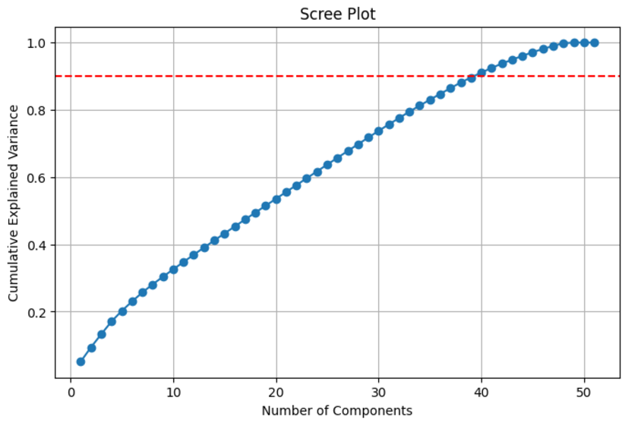
Data Preprocessing and Transformation
Data Transformation Summary
Principal Component Analysis (PCA):
Standardized all features to ensure equal importance.
Transformed scaled data into PCA space.
No of components that got selected for 90% Explained Variance
were 40, as shown in the graph.

Slide 8
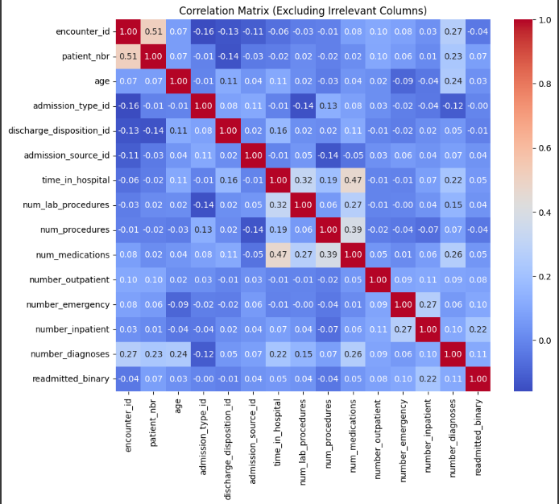
Data Preprocessing and Transformation
Feature Selection:
Dropped irrelevant columns (race, admission_type_id, etc.) before correlation analysis.
Correlation Matrix, shows the relation between features and helps us
selecting the most significant features
The red diagonal line shows that every feature is perfectly
correlated with each other
Some features (like num_lab_procedures, num_procedures, num_medications) might be directly related, which is helpful in predicting readmission or other outcomes.
Weak correlations with readmission (like those with time_in_hospital or encounter_id) suggest that these variables might have limited impact on the model's prediction of readmission status.

Slide 9
Data Preprocessing and Transformation
Final Dataset:
Prepared X (features) and y (target).
Split into training and testing sets (80%-20%).

Slide 10
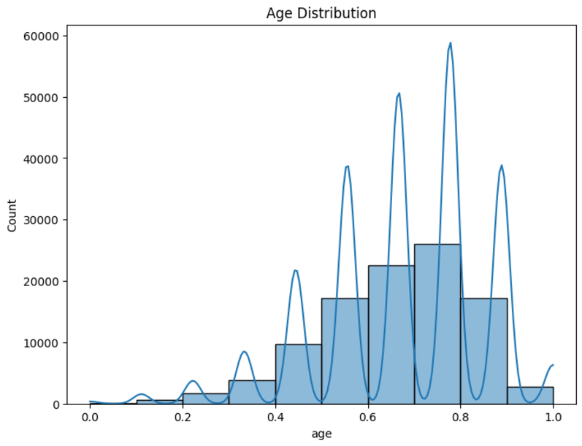
Exploration and Visualization
Univariate Analysis:
Age Distribution: - Visualized using a histogram to observe the age spread and density.
- According to the hist. minimum age lies in the range of 10-15 and max age from 80-90

Slide 11
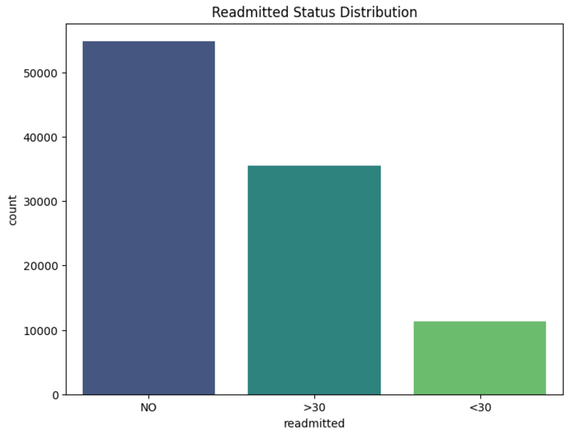
Exploration and Visualization
Readmitted Status: - Used bar plot to display the frequency of different readmission categories.
- According to the graph, majority of the
patients did not get readmitted

Slide 12
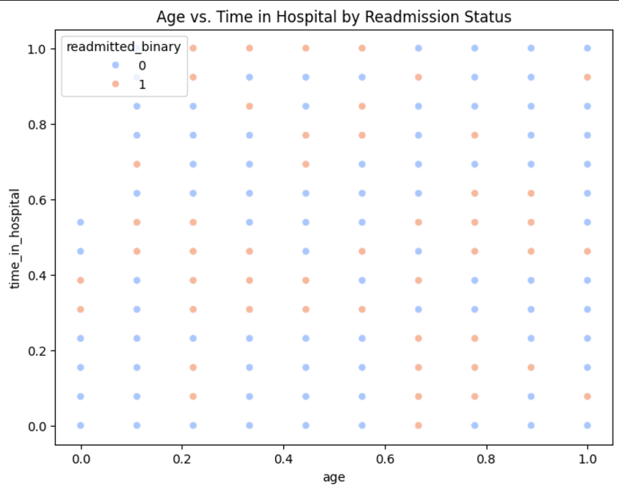
Exploration and Visualization
Bivariate Analysis:
Age vs. Time in Hospital: Used a scatter plot showing the relationship between age and hospital stay duration, colored by readmission status for trend identification.

Slide 13
Exploration and Visualization
Correlation Analysis:
Heatmap: Correlation matrix of numeric features revealed relationships between variables, helping identify relevant predictors for the model. *already attached*

Slide 14
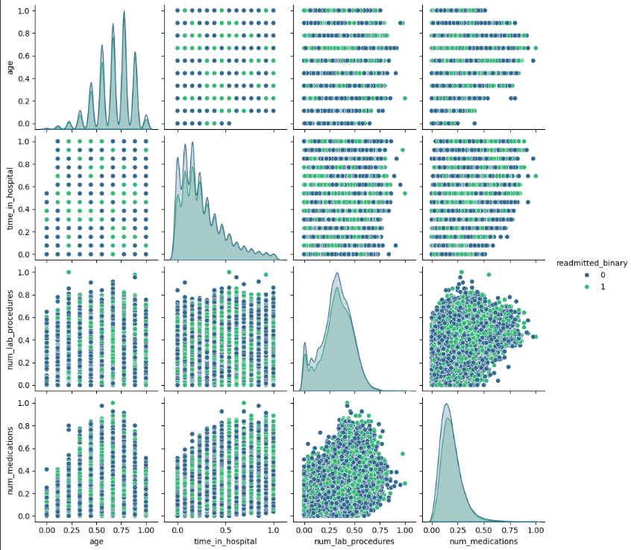
Exploration and Visualization
Multivariable Analysis:
Pair Plot: Showcased interactions between key features (age, time_in_hospital, num_lab_procedures, etc.) and highlighted differences by readmitted_binary.

Slide 15
ML Modeling
Feature and Target Selection:
X: Features excluding the target column (readmitted_binary).
y: Target variable (readmitted_binary).
Train-Test Split:
Stratified split (80% training, 20% testing) to maintain class distribution in both sets.
Model Training:
Random Forest Classifier:
Parameters: n_estimators=200, max_depth=10, min_samples_split=5, class_weight='balanced’.
Trained on X_train and y_train.

Slide 16
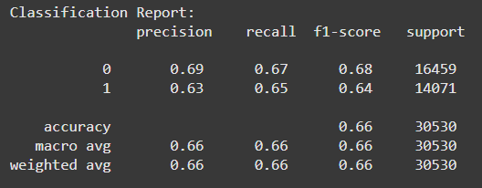
ML Modeling
Evaluation Metrics:
Confusion Matrix: Shows true positives, true negatives, false positives, and false negatives.
Classification Report: Includes precision, recall, F1-score, and support.
ROC-AUC: Measures model performance across thresholds.

Slide 17
Results
The results after data preprocessing, transformation and applying the ML model are;
Accuracy: 65%
Precision : 64%
Recall: 58%
F1-Score: 61%
ROC-AUC: 71%
Confusion Matric: [[7867 3085] [3956 5446]]

